Slide 1
Survival Project
2020-2021
Students: Shiqi Wang
Hao Zhu
Xiao Wang

Slide 2
Outline
Part A
Part B
Part C
Three Parts
Exploratory Analysis
Nonparametric Methods
Semi-parametric & Parametric Methods
Kaplan–Meier estimates
Quartiles of survival curves
Log-rank test
Cox Proportional Hazard Model
Model selection base on AIC
Relative Risk
Check Model Assumption
Parametric Survival Model
Model selection base on AIC
AFT & linear representation
Variable Exploration
Data Preparation
Kaplan–Meier estimates
Quartiles of survival curves
Log-rank test
Details
Outcome
Get Insights & Data Processing
Survival Curves Comparison
Model Selection & Interpretation

Slide 3
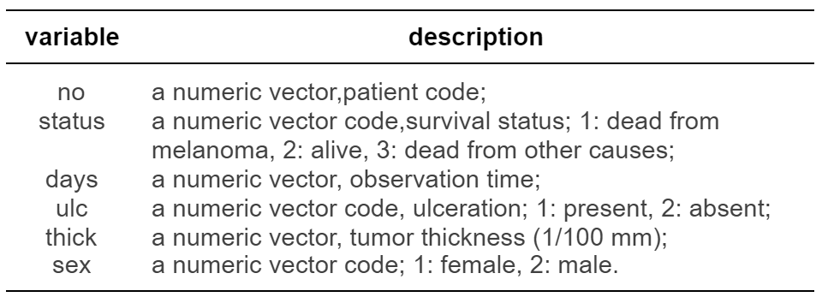
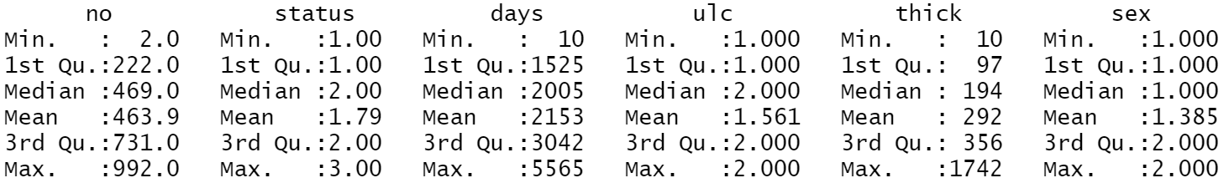
Part A - Exploratory Analysis
Variable Description
Consider observations with status 2 and 3 as censored.
Two categorical explanatory variables: sex, ulc.
One continuous explanatory variable: thick.
Summary Statistics

Slide 4
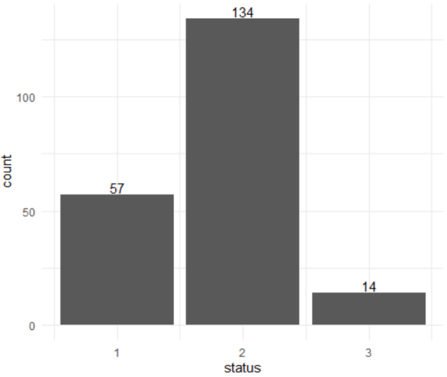
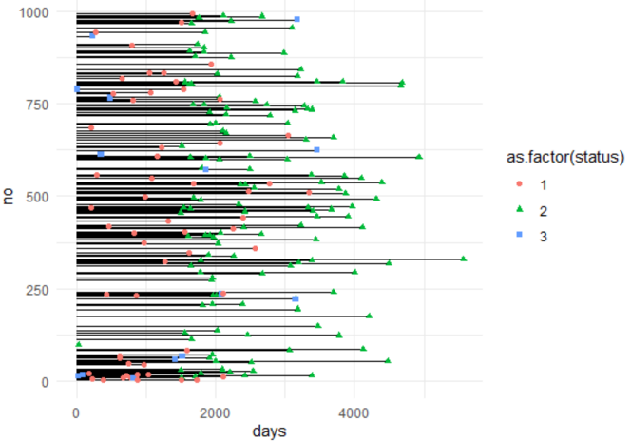
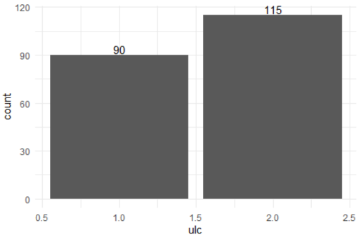
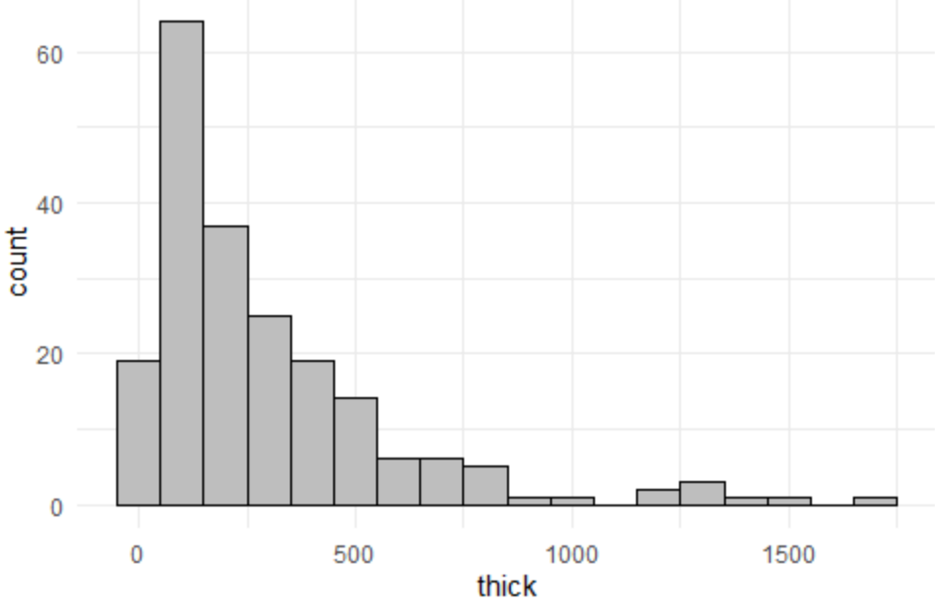
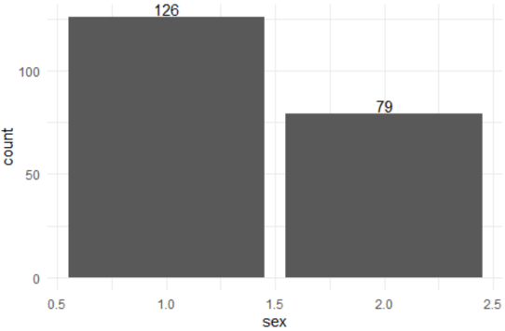
Part A - Exploratory Analysis
Visualization
More than a half of patients (134 out of 205) are still alive at the end of the study.
Less than a half of patients had ulceration appeared during the study.
The distribution of tumor thickness is right skewed.
Females patients are more than males.

Slide 5
Part A - Exploratory Analysis
Conclusion
In summary, the exploratory analysis suggests that most of the patients are still alive at the end of the study, which means most observations are censored in this case.
Besides, more than a half of patients have no ulceration during the study and there are more female patients than males.
Moreover, the distribution of tumor thickness is right skewed.

Slide 6
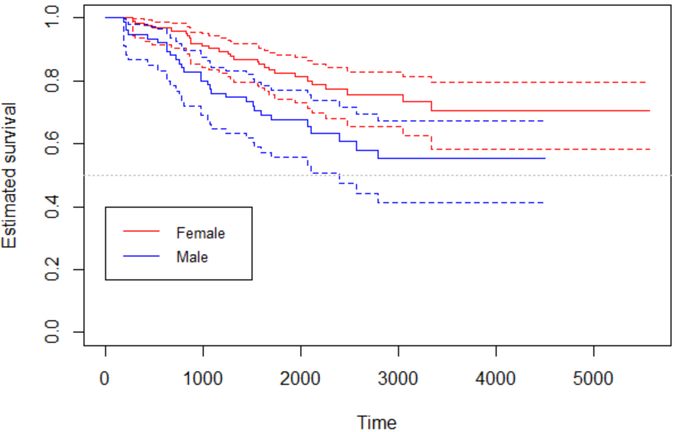
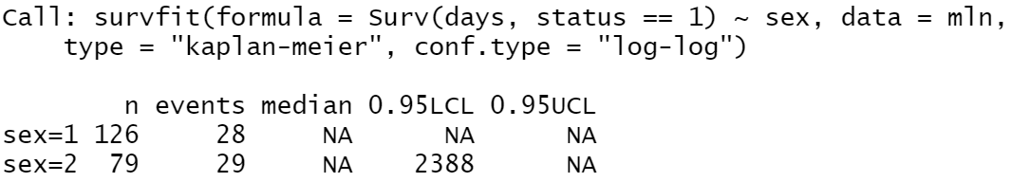
Part B - Nonparametric Methods
Kaplan–Meier estimates
To investigate if sex has an influence on patients’ survival probabilities, survival functions for females and males are computed using Kaplan–Meier estimates and log-log transformation.
It seems that females have higher survival chances than males at the same observation time
The estimates of the median of survival function is NA for survival functions for both males and females. This is because both of the survival curves did not reach the 50% line before the end of the study.

Slide 7
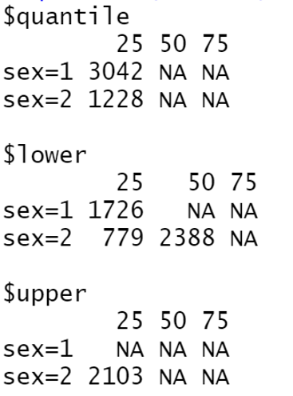
Part B - Nonparametric Methods
Quantiles of survival curves
To investigate if sex has an influence on patients’ survival probabilities, survival functions for females and males are computed using Kaplan–Meier estimates and log-log transformation.
Similarly, the NA in the first and third quantiles are due to the reason that the survival curves (or the confidence interval bound) have not reached the 75% and 25% respectively at the end of the study.
For interpretation, we can take the first quantile of males patients as an example.

Slide 8
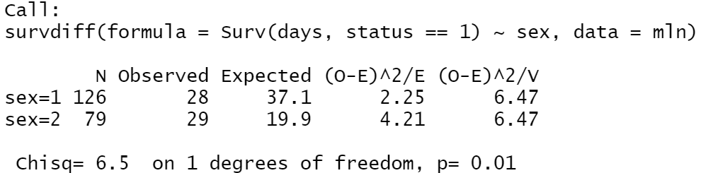
Part B - Nonparametric Methods
Log-rank test
A hypothesis test to confirm if there is a significant difference between the two survival curves.
The result of the log-rank test suggests that we should reject the null hypothesis of the test and there is significant difference between the two survival curves.

Slide 9
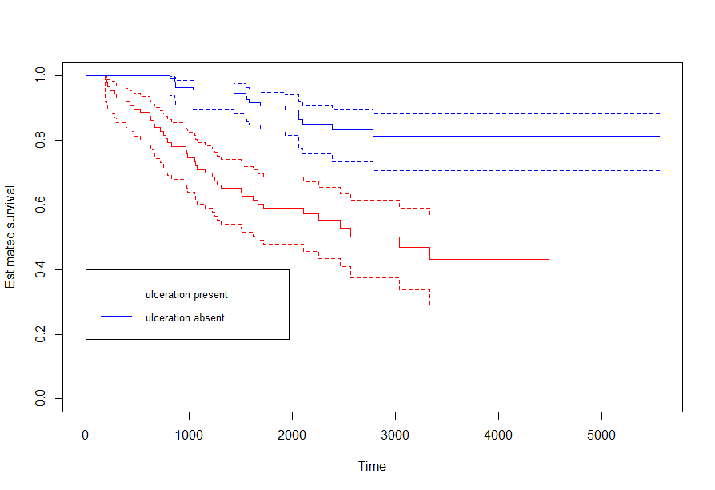
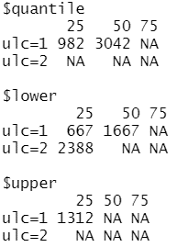
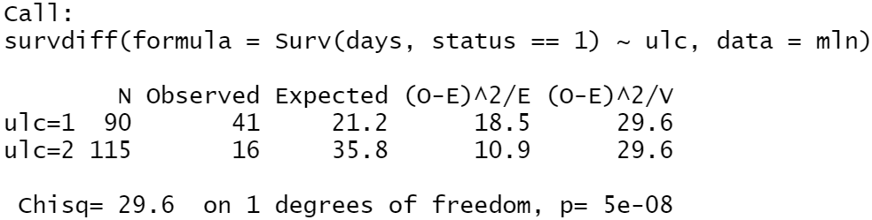
Part B - Nonparametric Methods
The other categorical variable: ulc
Similarly, we can investigate the other variable ulc in the same way.
The survival function for patients with ulceration reached the 50% line before the end of the study while patients without ulceration did not reached the line.
The result of the log-rank test suggests that we should reject the null hypothesis of the test and thus there is a significant difference between the two survival curves.

Slide 10
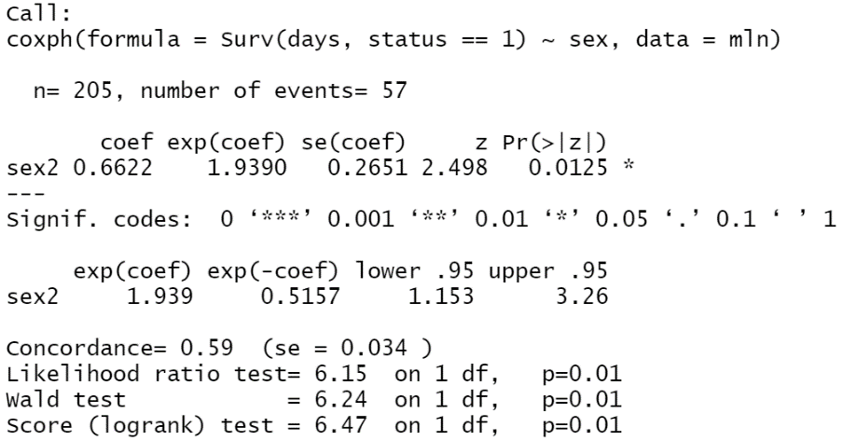
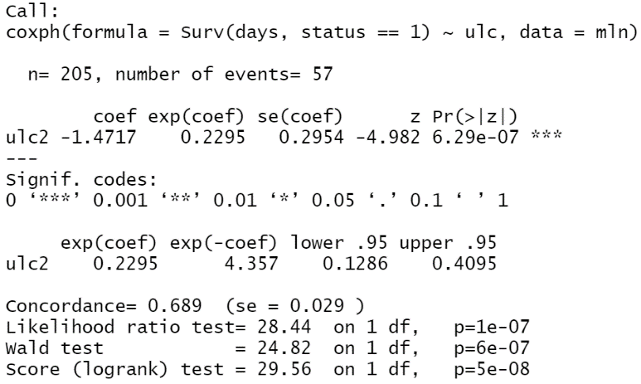
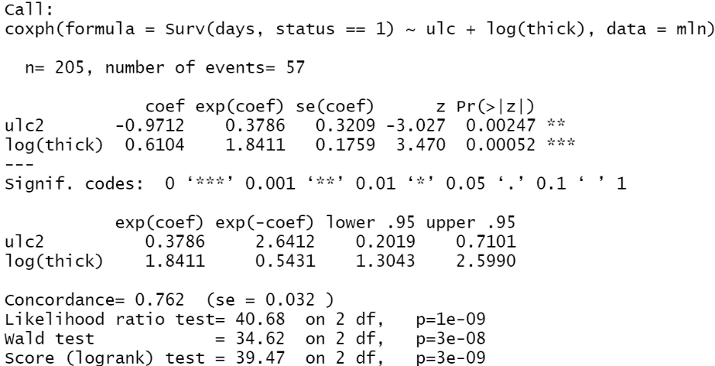
Part C - (a) Cox Proportional Hazard Model
Model Selection
After trying out several models, we found 3 models with one or multiple variables that show significant variable effects as well as significant global tests.
Model 1 AIC: 562.2479
coxph(Surv(days,status==1)~sex, data=mln)
Model 2 AIC: 539.9615
coxph(Surv(days,status==1)~ulc, data=mln)
Model 3 AIC: 529.7198
coxph(Surv(days,status==1)~ulc+log(thick), data=mln)
Relative Risk
In model 1, the relative risk (hazard ratio) for sex is 1.939 and the confidence interval is [1.153, 3.26].
In model 2, the relative risk for ulc is 0.2295 and the confidence interval is [0.1286, 0.4095].
In model 3, the relative risk for ulc is 0.3786 and the confidence interval is [0.2019, 0.7101]. The relative risk for log(thick) is 1.8411 and the confidence interval is [1.3043, 2.5990].

Slide 11


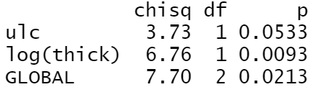
Part C - (a) Cox Proportional Hazard Model
Model Assumption
In the proportional hazard model, the hazard ratio between two subjects with different covariates is assumed to be constant over time. To check this assumption, the formal test is conducted.
Model 1 AIC: 562.2479
coxph(Surv(days,status==1)~sex, data=mln)
Model 2 AIC: 539.9615
coxph(Surv(days,status==1)~ulc, data=mln)
Model 3 AIC: 529.7198
coxph(Surv(days,status==1)~ulc+log(thick), data=mln)
Assumption Satisfied
Assumption Not Satisfied
Assumption Not Satisfied
Although model 3 has the smallest AIC, it does not fulfill the constant relative risk assumption. As a result, we will select model 1 as the final Cox model.

Slide 12
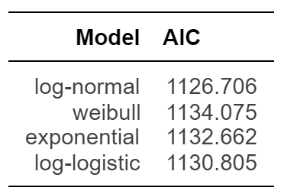
Part C - (b) Parametric Survival Model
Model Selection
Model 1 is the model selected for the previous model and we will build an appropriate parametric model based on four different distributions.
The log-normal model has the smallest AIC among the four models, so we chose the log-normal model as the appropriate model.

Slide 13
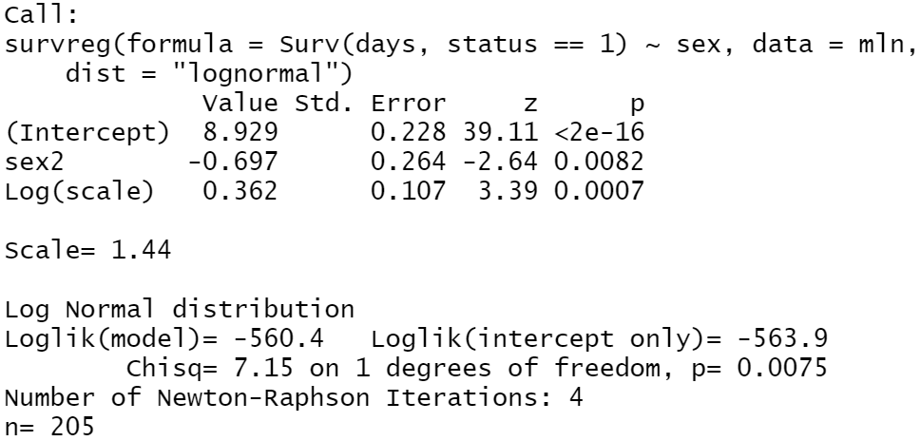


Part C - (b) Parametric Survival Model
AFT & Linear model representations
Model 1 is the model selected for the previous model and we will build an appropriate parametric model based on four different distributions.
Estimates in AFT Mode
Estimates in Linear Model
Estimates in AFT Model
The summary of AFT model representation:
The vector of regression coefficients of AFT model is negative to the vector of regression coefficients of linear model.
We can use these equations θ=-γ to get the estimated parameter γ in the linear model representation.
Point and interval estimates of the coefficient:

